Slide 1
Modelling explosive percolation under local rules: replicating paper results
December 4, 2018
Shannon Moran
Notes:
I’m a PhD Candidate in Chemical Engineering, but more relevant to the topic of this lecture, I spent 3 years at the Boston Consulting Group in Chicago before coming back to school working on projects for chemicals and health care clients. I know in this class you all will be working on consulting projects this semester, and a number of you are likely also thinking about going into consulting after graduation. How many of you are thinking of going into consulting, whether management or technical or something else? Okay, great. In consulting, or any industry really, running an effective meeting is one of the easiest and most critical ways of earning your client’s respect and trust. It is the easiest way of showing that you are in control of the process. I’m going to frame this through both the lens of what meetings look like out in the real world and lessons you can apply to your teams in this class, but also want tie this into experiences you probably have now with your advisors and collaborators. Any questions before we get in?

Slide 2
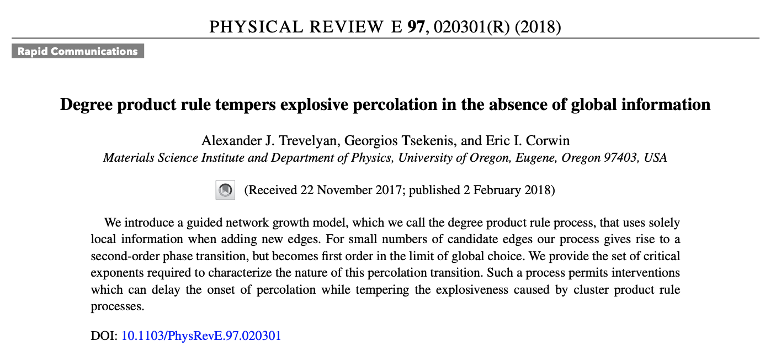
1

Slide 3
What are network growth models, how do they relate to percolation?
Site occupation under local rules
Edge occupation under local rules
https://commons.wikimedia.org/wiki/File:Front_de_percolation.png
http://www.eng.ox.ac.uk/sen/files/course2016/lec1.pdf

Slide 4
We can think of network percolation as occupied edges, rather than sites
Building an Erdős-Rényi network
Proposed edge:
(0,4)
(2,3)
(5,1)
Initialize N nodes (unique order)
Pick two nodes at random: (tail, head) of edge
Add edge
Repeat 2&3 until t edges are added
1
2
0
3
Edge density = p = t/N
5
4
3 clusters of 2 nodes each
Source: P. Erdős and A. Rényi, On Random Graphs, Publ. Math. 6, 290 (1959)

Slide 5
In this paper, the authors investigate three different network percolation methods
Erdős-Rényi
Science, 2009
Achlioptas growth process (AP)
Degree product rule (DPR)
Initialize N nodes
Pick two nodes at random
Add edge
Repeat 2&3 until t edges are added to reach an edge density of p
Initialize N nodes
Pick m sets of two nodes at random (“edge”)
For each edge, calculate the total cluster size created by the edge
Add edge that creates the smallest new cluster
Repeat 2-4 until t edges are added to reach an edge density of p
Initialize N nodes (unique order)
Pick m sets of two nodes at random
For each edge, calculate the “degree product” of the component nodes: (d₁+1)(d₂+1)
Add edge that has the lowest “degree product”
Repeat 2-4 until t edges are added to reach an edge density of p
Creates a “powder keg” for explosive percolation by suppressing cluster growth
Assert a second-order phase transition for small m and a first-order transition for global m

Slide 6
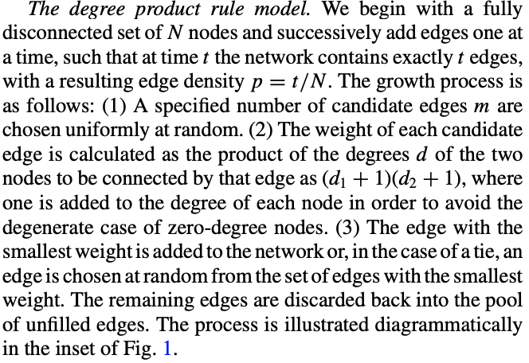
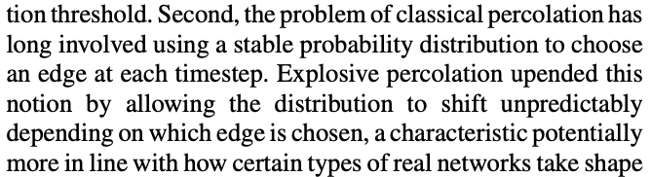
What is this paper looking to do? Why should we care?
AP and DPR are two methods generally called “competitive edge addition” methods
These methods can often lead to what is called explosive percolation “due to the abruptness with which the largest cluster grows from microscopic to system spanning”
But why bother looking at DPR?
It relies only upon local node information– no need to calculate full cluster information for each edge addition

Slide 7
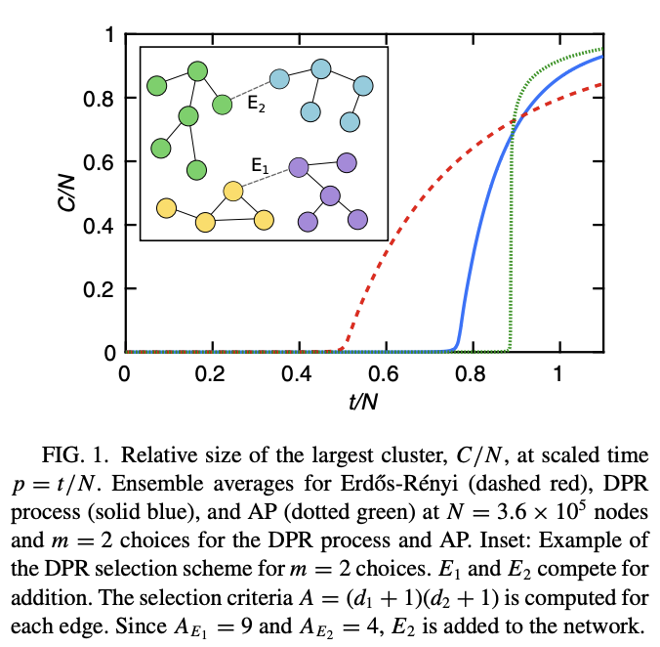
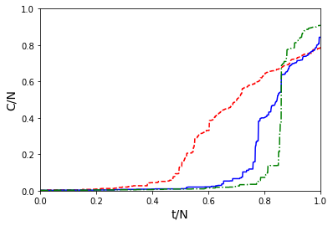
Figure 1: Validate that my model can replicate evolution of large cluster size over time
DPR example: E2 is chosen
Paper
My results
Able to replicate the trends in cluster size evolution over edge density
This is interesting: paper uses N=3.6E5 nodes, while I was only able to run N=1E3
Critical point/nature of transition does not appear to be network-size-dependent

Slide 8
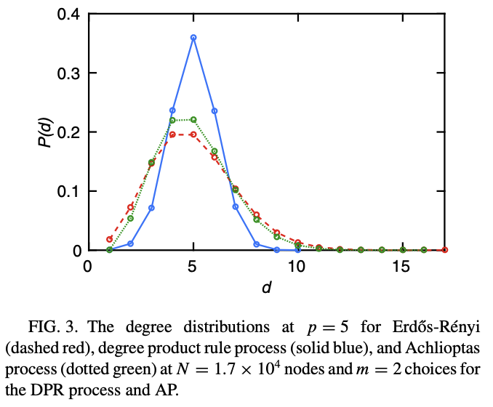
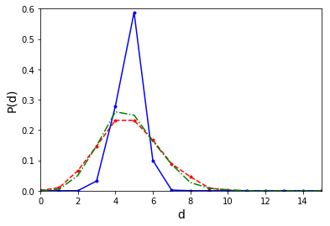
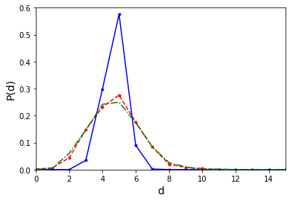
Figure 3: Validating that my model replicates the correct edge degree distribution
Paper
My results
N = 1.7E4
N =1E3
1E3
The micro-environment of my networks is the same as those in the paper-- good!
However, my simulation sizes will start to present problems when I look to calculate critical exponents and study phase trans
N = 5E2
1
3
1
3
1
1
2
1
2

Slide 9
Figure 2: Troubles with system size begin when studying the “largest jump” order parameter (1/2)
Maximum jump in the order parameter over a number of system sizes
Lol, way off– going to need to go larger.
Have a few tricks up my sleeve to try to get into larger system sizes
Implemented via binary search
Binary search to find “largest jump in C/N” order parameter for study
1
Divide x-range into two segments (“binary’)
Check in which range the jump in y is greatest
Re-do search in that region and repeat until x-range can no longer be divided
2
3
3
2
1
3
1
2

Slide 10
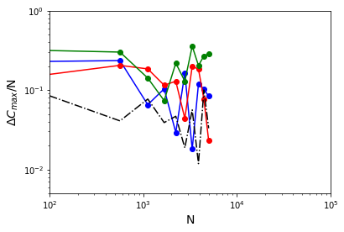
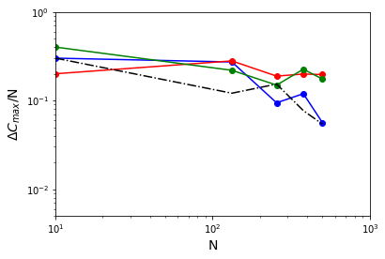
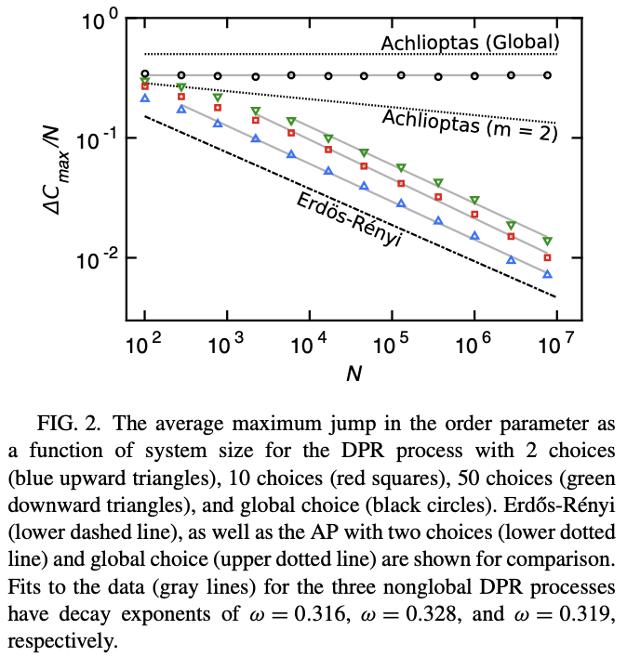
Figure 2: Troubles with system size begin when studying the “largest jump” order parameter (2/2)
Maximum jump in the order parameter over a number of system sizes
Lol, way off– going to need to go larger.
Have a few tricks up my sleeve to try to get into larger system sizes
Implemented via binary search
Paper
My results
Characterizing the critical behavior will require accessing larger system sizes
Next steps: Run systems longer on non-laptop systems
Also not yet added: Global m search for network generation algorithms

Slide 11
DPR’s critical behavior is independent of the number of choices at each edge addition step
For the AP process, changing the number of edge choices (m) changes the decay exponent
For DPR, the decay exponent is not a function of the number of choices
However, global choice does lead to a phase transition (order parameter independent of N)

Slide 12
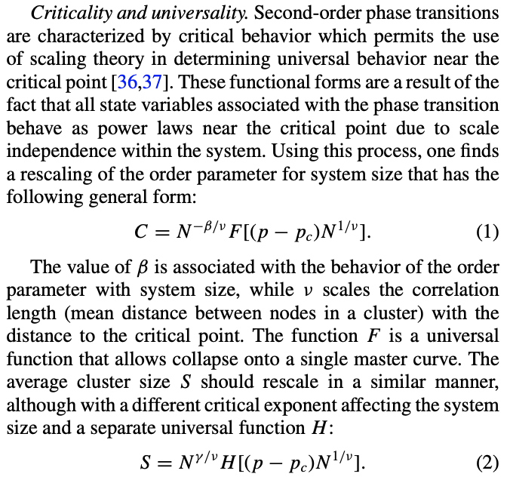
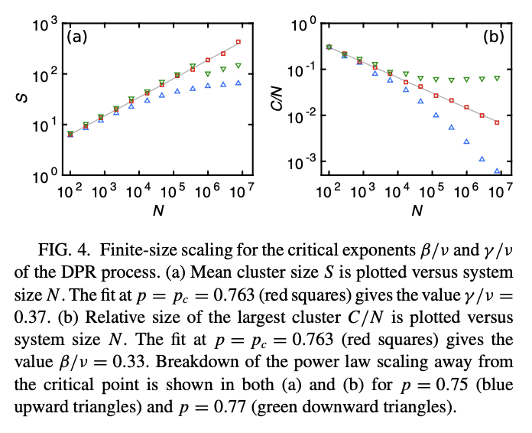
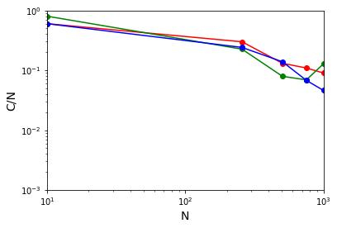
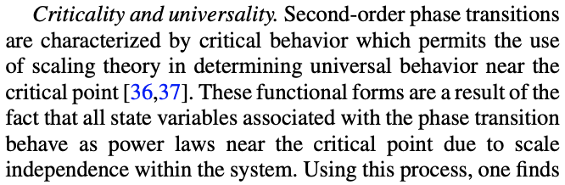
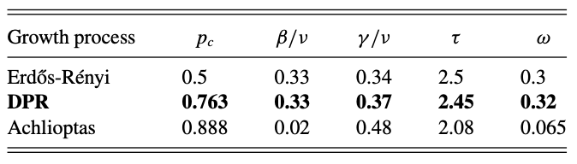
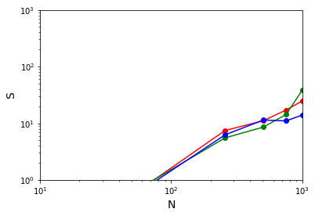
Critical behavior: Without larger systems, I cannot replicate the critical exponent calculations
Paper
My results
Trend is correct, but too small of systems!

Slide 13
Challenges and next steps: Larger systems!
I was very limited in the sizes of systems I was able to analyze, which hindered my ability to replicate the analysis of the critical behavior
The paper went up to systems with 10^7 nodes; I had trouble even with 10^4 nodes for the AP network (the most computational intensive to run)
I suspect I can get larger systems by running on not-my-laptop, and can parallelize network analysis to speed up overall performance
I’m currently also digging into the Networkx (python package) source code to see if I can find areas for optimization
Goal before report submission: Run up to 10^5 systems

